Slide 1
Level 3
Student’s name:

Slide 2
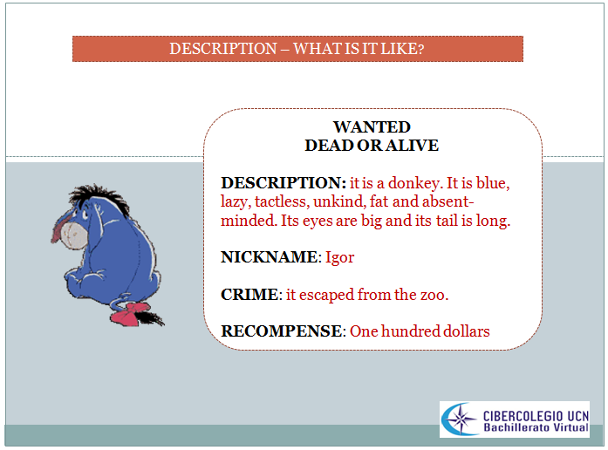
Follow the model to make a description from a person. Send the pronunciation

Slide 3
WANTED:
DEAD OR ALIVE
NICKNAME:
RECOMPENSE:
DESCRIPTION
IMAGE

Slide 4
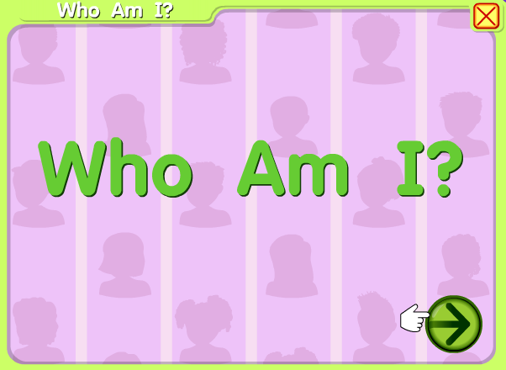
Go to http://www.starfall.com/n/me/me/load.htm?f choose the eyes, hair, mouth…..and when you finish, send a picture from the image

